Slide 1
VTI ELK CAPABILITY & USE CASE PORTFOLIO
Executive Summary
VTI provides enterprise-grade ELK-based observability platforms
Proven experience across:
Hybrid cloud (On-prem + AWS)
Large-scale systems (microservices, distributed infra)
Security & operational monitoring
Capability goes beyond logging → Observability + Security + Analytics Platform
Capability Overview - What VTI Can Deliver
Observability Platform
Centralized logging across:
Applications, infrastructure, network, cloud
Real-time monitoring & alerting
Full-text search & deep log analytics
VTI enables ELK as a strategic platform:
Real-time observability
Security intelligence
Scalable cloud-native monitoring
Not just logging — Operational intelligence for PRO-scale systems
Advanced Processing
Log normalization & enrichment
Custom pipelines (Logstash)
Domain-specific log modeling:
Telco / Banking / Retail
Security (SOC-lite)
Log correlation rules
Anomaly detection (rule-based)
Audit & compliance tracking
Level | VTI’s Capability
L1 | Basic logging
L2 | Centralized logging
L3 | Observability platform
L4 | Security (SOC-lite)
L5 | AI-driven analytics
Scalable Architecture
Multi-node Elasticsearch cluster
High-volume ingestion (GB → TB/day)
Hot–Warm–Cold data tiering
Cloud & DevOps Integration
Kubernetes / microservices monitoring
CI/CD pipeline integration
Multi-cloud (AWS / GCP / Azure)
VTI current level: L3–L4
Next step: AI-driven anomaly detection (Demo/ PoC)

Slide 2
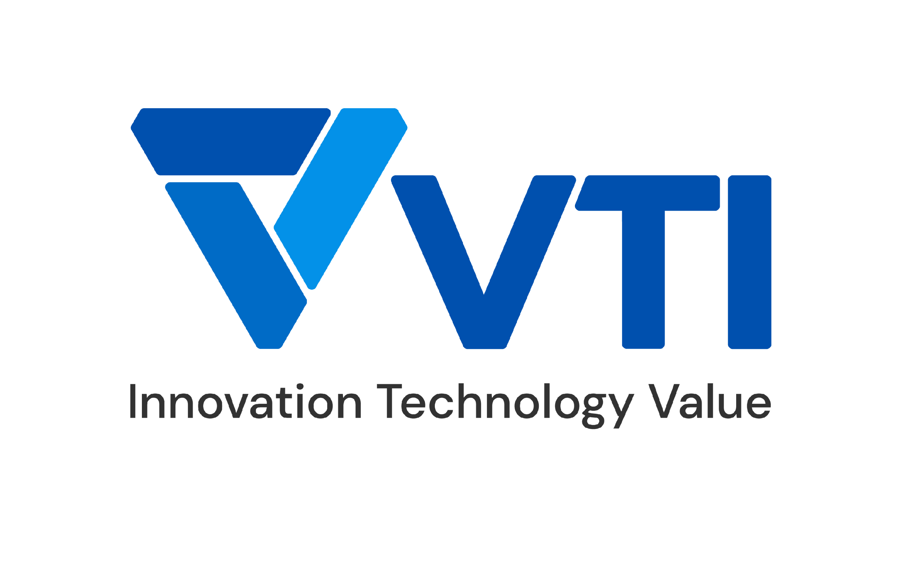


CASE STUDIES
11
Copyright © 2025 VTI All rights reserved

Slide 3

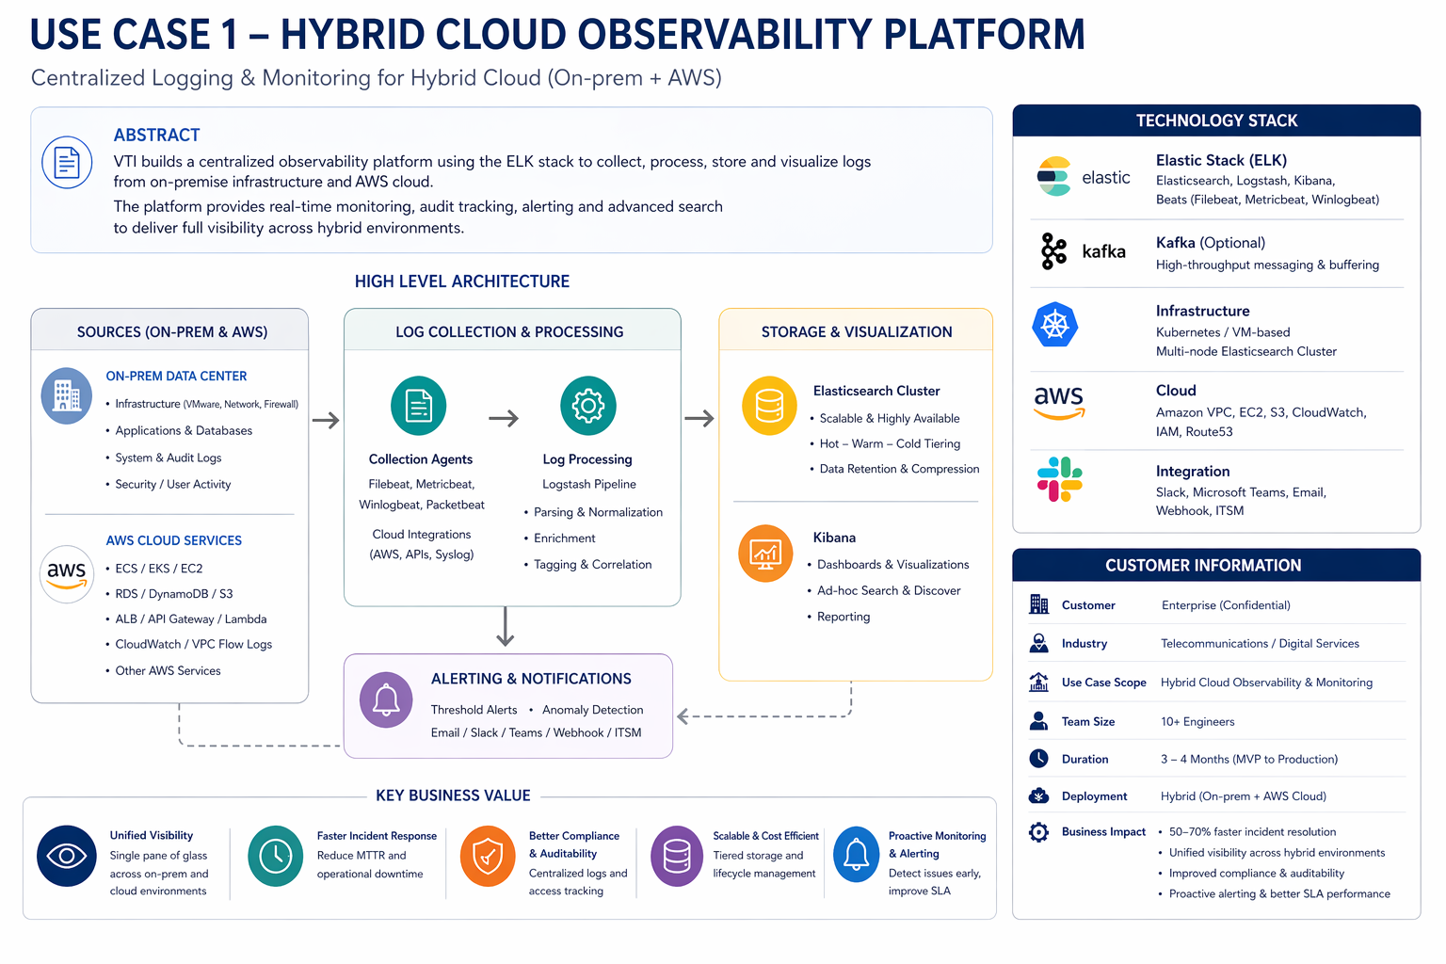

Key Use Cases in Operation
Hybrid Cloud Observability Platform
Overview
Enterprise environment with:
VMware (on-prem)
AWS cloud
Multiple applications & services
Lack of centralized monitoring & audit visibility
Telco Relevance
Multi-data center monitoring
Network node observability
Core system operations visibility
Solution & Technology Used
ELK-based centralized logging platform:
Collect logs from VM, network, application layers
Unified dashboard (Kibana)
Real-time alerting
Highlight
Full-text search across all systems
Infrastructure + application observability
Audit log tracking (user activity, system events)
Alert integration (Email / Slack / ChatOps)
Business Value
Single-pane visibility across hybrid environments
Faster incident response (MTTR reduction)
Improved governance & compliance
3
Copyright © 2025 VTI All rights reserved
Notes:
In this use case, we implemented a centralized observability platform for a hybrid cloud environment combining on-premise infrastructure and AWS.
This case is derived from our internal VM Platform solution, where we manage hybrid environments including VMware, network systems, and cloud integration.
We used ELK to collect, search, and visualize system logs across infrastructure, applications, and user activity.
The platform provides real-time monitoring, audit tracking, and alerting.
The result is improved visibility, faster incident response, and better governance across hybrid environments.
For telco, this directly applies to multi-data center operations and network observability.
(Nguồn CS: VM Platform + ELK log analysis module)

Slide 4
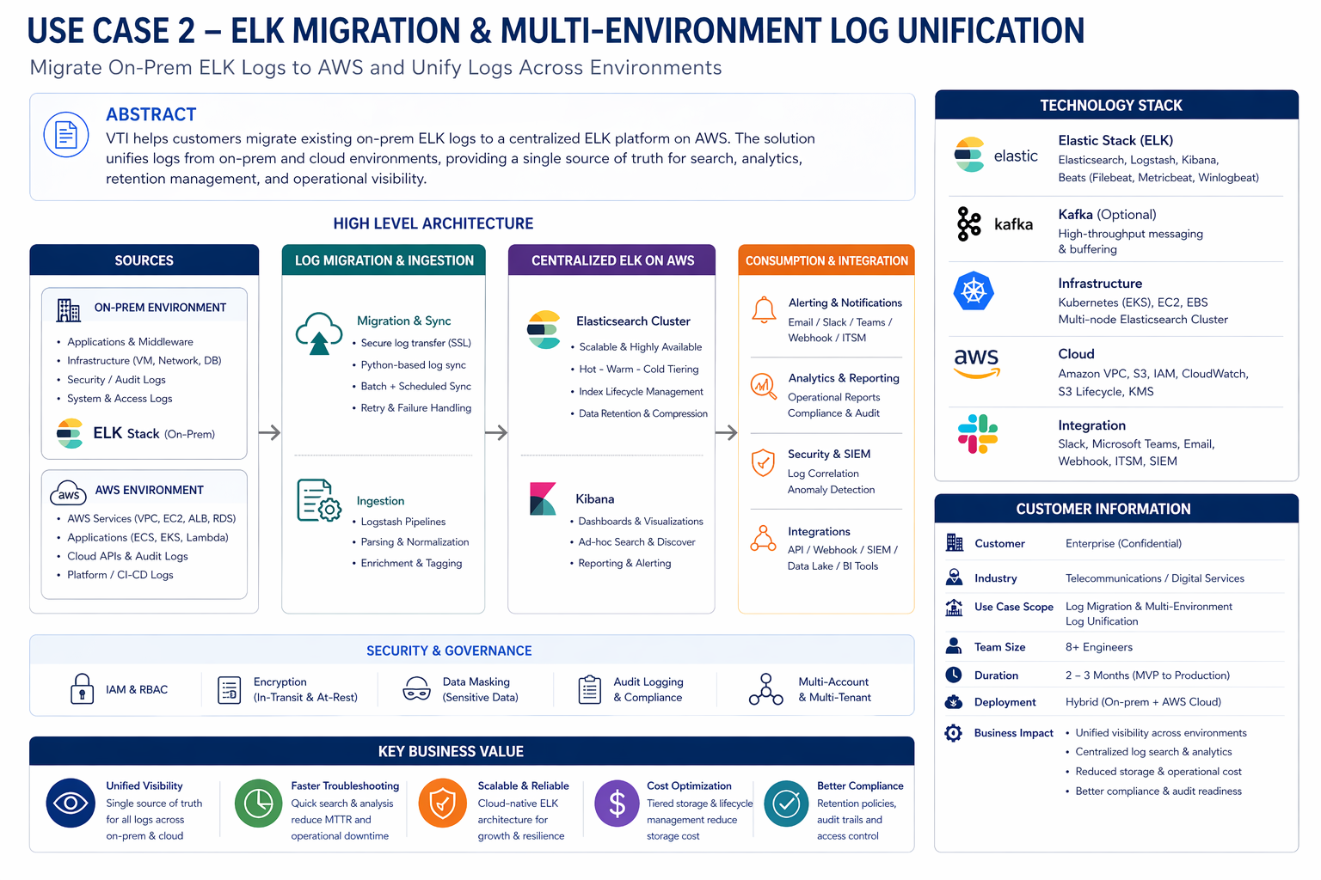
Key Use Cases in Operation
ELK Migration & Multi-Environment Log Unification
Overview
Existing ELK deployed on-premise
Cloud systems running on AWS
Need unified logging & scalable architecture
Telco Relevance
Legacy system modernization
Multi-region log aggregation
Data center consolidation
Solution & Technology Used
Deploy ELK on AWS (Kubernetes-based)
Migrate logs from on-prem → cloud
Synchronize and centralize log storage
Highlight
Cross-environment log aggregation
Secure ingestion (SSL, authentication)
Data migration (batch + scheduled sync)
Log lifecycle management (rotation & retention)
Business Value
Unified observability platform
Improved scalability & performance
Reduced operational complexity
4
Copyright © 2025 VTI All rights reserved
Notes:
This use case is based on a real migration project we delivered for a media platform system.
The customer had an ELK system running on-premise and needed to migrate logs to AWS while unifying logs across environments.
We designed a migration solution using secure log transfer and batch synchronization, moving data from on-prem Elasticsearch to AWS Elasticsearch.
This created a centralized logging platform with better scalability and operational visibility.
This approach is highly relevant for telco scenarios involving legacy system migration and multi-region environments.
(Nguồn CS: Vodaplay ELK Migration Plan & AWS deployment scenario)

Slide 5
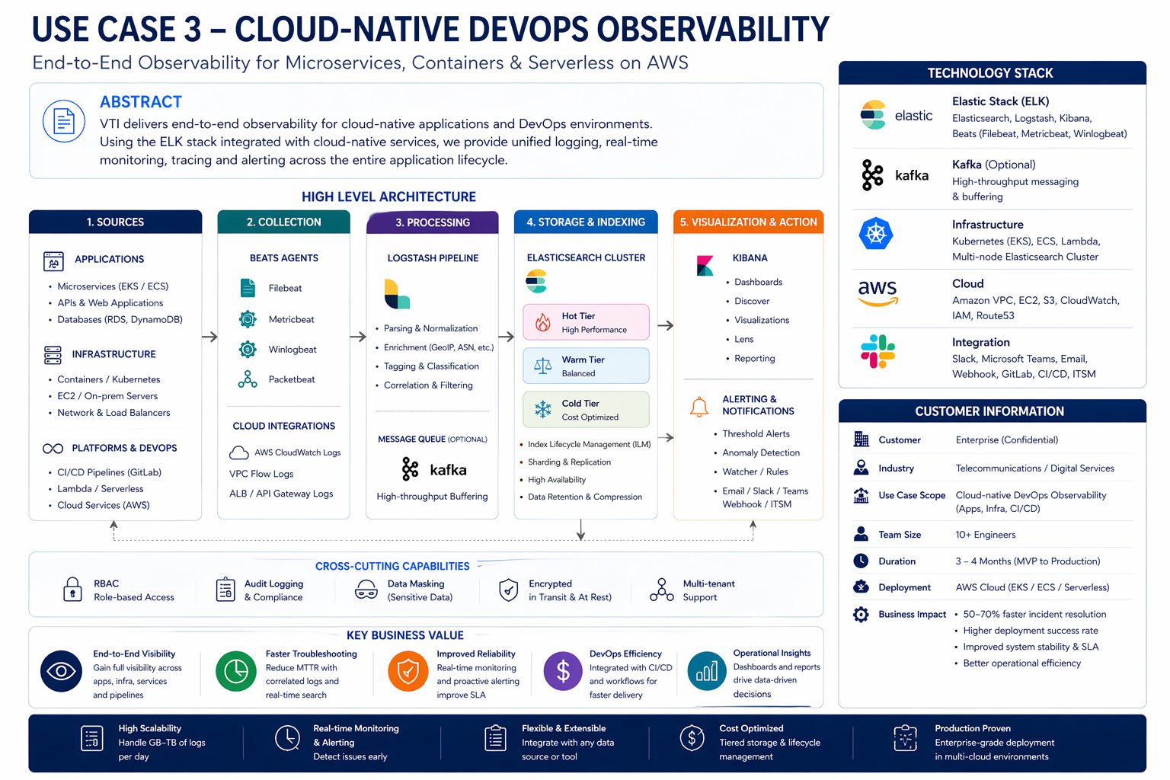
Key Use Cases in Operation
Cloud-native DevOps Observability
Overview
Microservices architecture (EKS / ECS / Lambda)
Distributed systems with high operational complexity
Limited traceability and debugging capability
Telco Relevance
Digital platforms (apps, portals, OTT)
API gateway monitoring
Microservices-based telco systems
Solution & Technology Used
Centralized logging across:
Applications
Infrastructure
CI/CD pipelines
Integrated observability stack
Highlight
End-to-end request tracing
Real-time monitoring:
API latency
Error rates
Resource usage
Alerting:
5xx error spikes
DB connection failures
Business Value
50–70% faster troubleshooting
Improved deployment reliability
Enhanced system stability
5
Copyright © 2025 VTI All rights reserved
Notes:
This use case comes from our cloud-native deployment projects using AWS, Kubernetes, and microservices architecture.
In this environment, logs and metrics are distributed across multiple services, making troubleshooting complex.
We implemented centralized observability using ELK integrated with cloud-native services such as EKS, ECS, and CI/CD pipelines.
This enables end-to-end visibility from API requests down to infrastructure and database layers.
The result is faster troubleshooting and improved system reliability.
This is directly applicable to telco digital platforms and API ecosystems.
(Nguồn CS: Vodaplay production architecture + CI/CD + monitoring & logging design)

Slide 6
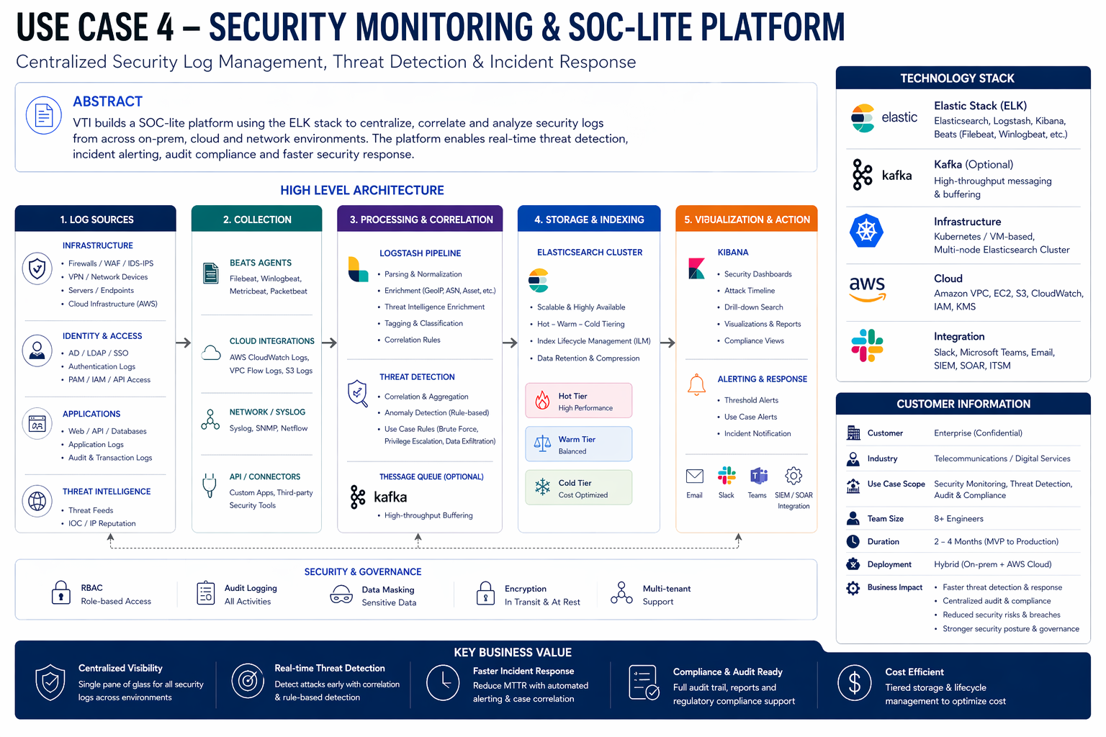
Key Use Cases in Operation
Security Monitoring & SOC-lite Platform
Overview
Lack of centralized security monitoring
Distributed logs across systems
Telco Relevance
Subscriber fraud detection
API abuse monitoring
Internal security operations
Solution & Technology Used
ELK-based security monitoring platform
Correlation of logs across:
Applications
Network
User access
Highlight
Detect:
Abnormal login behavior
Suspicious access patterns
Real-time alerts
Full audit trail
Business Value
Improved threat detection
Faster incident response
Foundation for SOC implementation
6
Copyright © 2025 VTI All rights reserved
Notes:
This use case is an extension of our observability platform into a security monitoring solution.
It is derived from multiple projects where we implemented audit logging, user activity tracking, and log-based alerting.
Using ELK, we correlate logs from applications, infrastructure, and access systems to detect abnormal behaviors.
We also implement rule-based detection for suspicious activities and real-time alerting.
This provides a foundation for SOC-lite capabilities such as threat detection and compliance monitoring.
For telco, this applies to fraud detection, API abuse monitoring, and internal security operations.
(Nguồn CS: VM Platform audit log + ELK + security monitoring extensions)

Slide 7
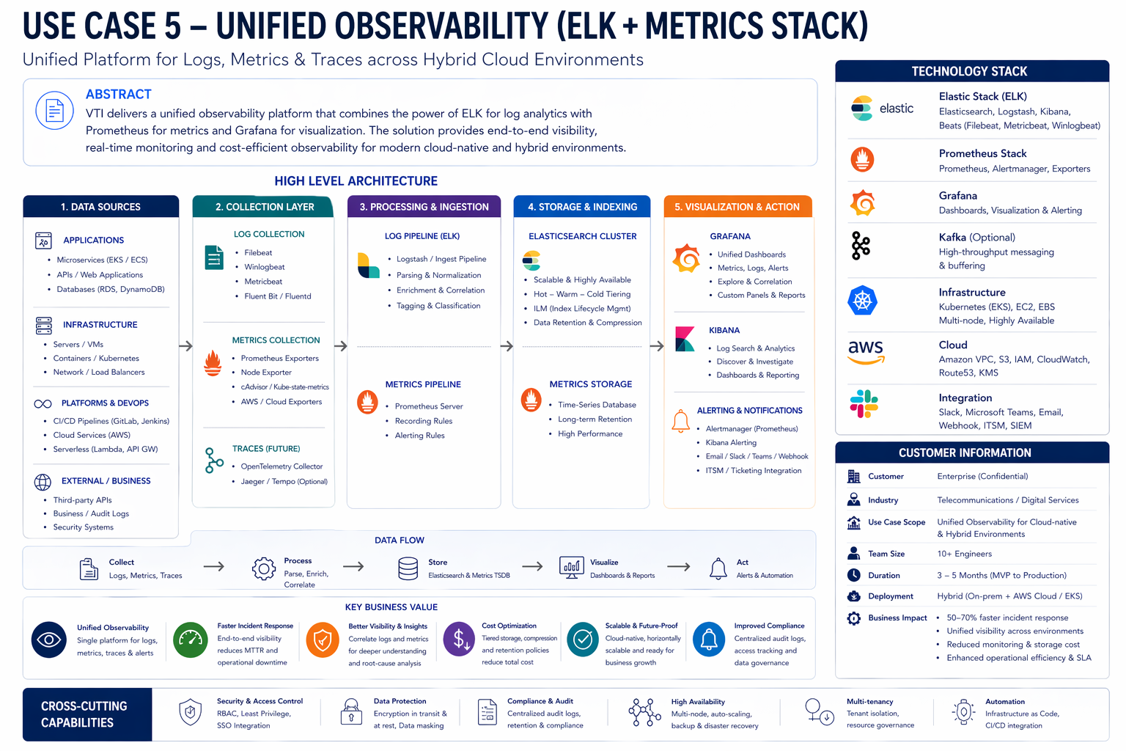
Key Use Cases in Operation
Unified Observability (ELK + Metrics Stack)
Overview
Need unified monitoring:
Logs + Metrics + Dashboards
Performance & cost optimization challenges
Telco Relevance
5G / edge systems
High-scale distributed environments
Kubernetes-based telco platforms
Solution & Technology Used
Combined architecture:
ELK (log processing & analytics)
Prometheus (metrics)Grafana (visualization)
Loki (lightweight log storage)
Highlight
Unified observability platform
Real-time dashboards
Flexible, scalable architecture
Cost optimization
Business Value
Better operational insights
Reduced monitoring cost
Cloud-native observability readiness
7
Copyright © 2025 VTI All rights reserved
Notes:
This use case is based on our internal R&D and deployment experience combining ELK with metrics monitoring tools such as Prometheus and Grafana.
ELK is used for deep log analysis and search, while Prometheus collects real-time metrics and Grafana provides visualization.
This creates a unified observability platform that combines logs, metrics, and dashboards.
The benefit is better performance monitoring, cost optimization, and more advanced operational insights.
This architecture is especially suitable for large-scale, distributed environments like telco systems and 5G platforms.
(Nguồn CS/ Demo: Prometheus–Grafana–Loki internal demo + ELK integration practice)

